Slide 1
tail odds at U vs N
detecting if dist is U or N by checking samples at the tails

Slide 2
what we’re checking
we have ‘x’ samples, and we need to decide if it’s uniform on ‘u_size’ or it’s normal dist with std of ‘n_std’. both dists with evg of 0
we can absorb detection of normal dist as uniform, but we don’t want detection of uniform as normal
how we decide?
we will look at the edges of the u_size – some threshold, if we have even one sample there, it’s uniform, and if not, it’s normal

Slide 3


error calculation
detecting uniform as normal
$${\left(\frac{2x}{u_{size}}\right)}^{samples}$$
detecting normal as uniform
$$1−{\left(1−\sim n\left(0,n_{std}\right).cdf\left(−x\right)∗2\right)}^{samples}$$
$$= 1−{\left(\operatorname{erf}\left(\frac{x}{\sqrt{2}∗n_{std}}\right)\right)}^{samples}$$

Slide 4
case
mod size 8.8 edge to edge (best for ~N(0,1) with more than 5 bins quantizer)
when A not fixing the data we will get U dist
we can use kurtosis or check estimated STD, but here we look only on the tail

Slide 5
lets look at the tails of 10% of the modulo
for modulo of 8.8 edge to edge:
the odds for U to get one sample, out of 1, at the tails is 20%
the odds for N is x<-3.96 (X2 because we have 2 tails) is 7.4e-5
for 5 samples:
U: 1-0.8^5=0.672
N: 1-(1-7.4e-5)^5= 0.000369
error detecting N when it’s U:
all U are under threshold: 67%
error detecting U when it’s N:
at least 1 sample of 5 is outside threshold: 0.037%
very bad odds to say it’s N when it’s U…

Slide 6
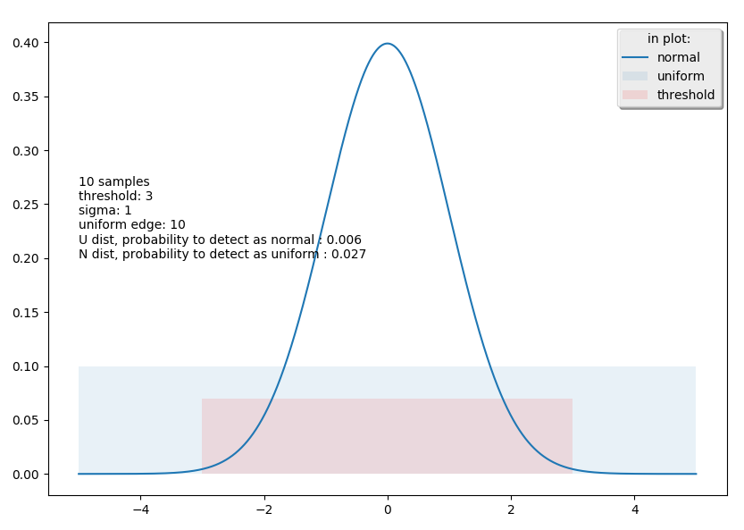
module of 10, threshold at 20% with 10 samples
import scipy.stats as st import pylab as plt import matplotlib.patches as patches import numpy as np def errors(u_size, threshold, n_std, samples): ''' when you have inside threshold, you point N and outside you point U ''' # u_error means that you have u and you dont have samples outsize the threshold u_error = (threshold * 2.0 / u_size) ** samples # n_error means that you have n and you have samples outsize the threshold n_to_be_outsize = (1 - st.norm(0, n_std).cdf(threshold)) * 2 n_error = 1 - (1 - n_to_be_outsize) ** samples return u_error, n_error samples = 10 modulo = 10 sigma = 1 threshold=3 u_error,n_error=errors(modulo, threshold, sigma, samples) U_N_errors="%d samples\nthreshold: %.02g\nsigma: %.02g\nuniform edge: %.02g\nU dist, probability to detect as normal : %.02g\nN dist, probability to detect as uniform : %.02g"%(samples,threshold,sigma,modulo,u_error,n_error) print(U_N_errors) fig1 = plt.figure() ax = plt.gca() x_axis = np.arange(-5 * sigma, 5 * sigma, 0.001) plt.plot(x_axis, st.norm.pdf(x_axis, 0, sigma),label="normal") ax.add_patch(patches.Rectangle((-modulo / 2.0, 0), modulo, .1, alpha=0.1,label="uniform")) ax.add_patch(patches.Rectangle((-threshold, 0), 2*threshold, .07, alpha=0.1,facecolor="red",label="threshold")) plt.legend(loc="best",ncol=1, shadow=True, title="in plot:") plt.text(-5 * sigma,0.2,U_N_errors) plt.show()

Slide 7
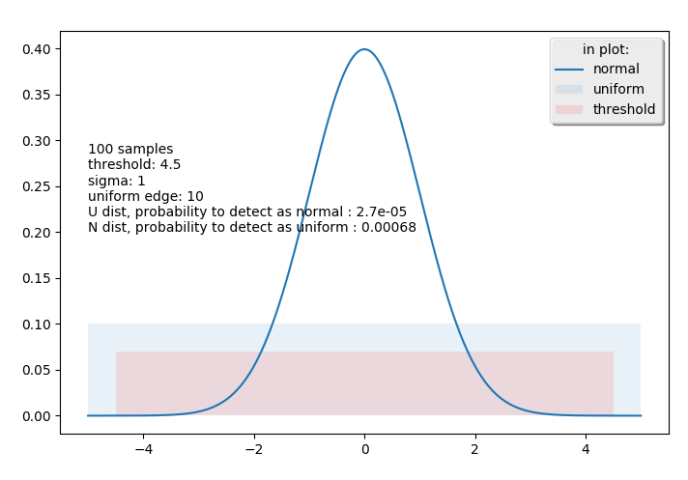
more samples at the same threshold
as we take more samples, we will be better at U but worse at N
to compensate this, we will take larger threshold

Slide 8
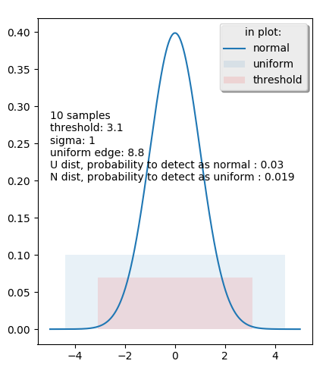
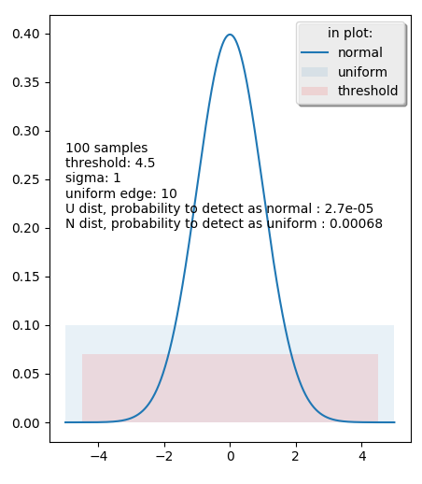
our module - std ratio is 8.8:

Slide 9
errors vs threshold
let find our best threshold, at module 8.8, sigma 1

Slide 10
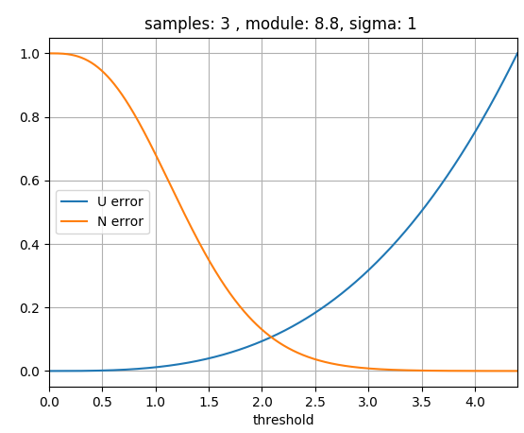
3 samples

Slide 11
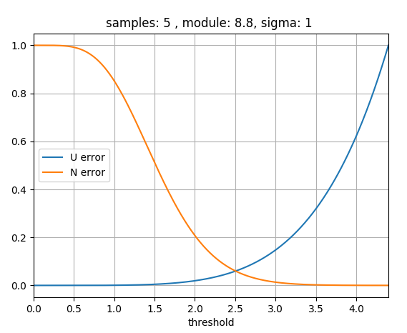
5 samples

Slide 12
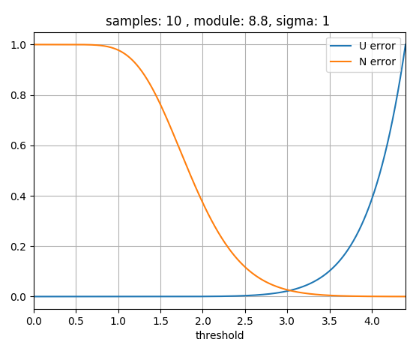
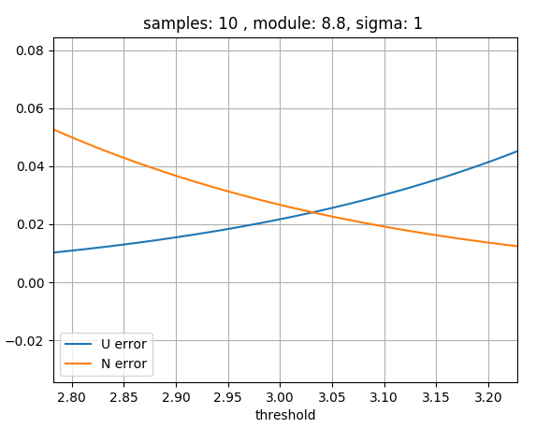
10 samples

Slide 13
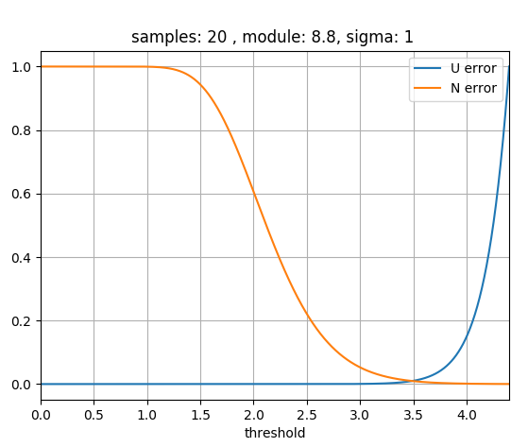
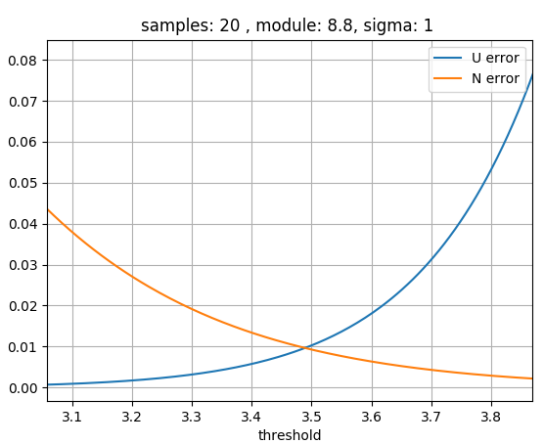
20 samples

Slide 14
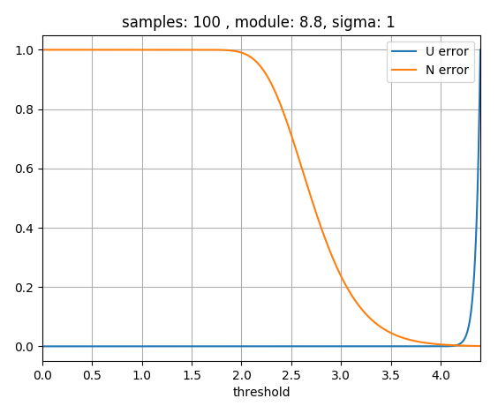
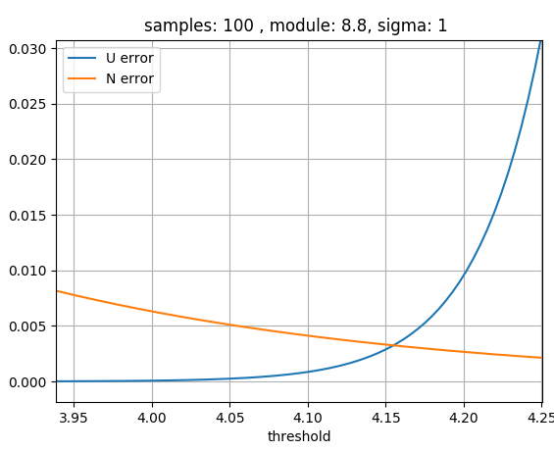
100 samples

Slide 15
errors vs threshold
at different sigma size

Slide 16
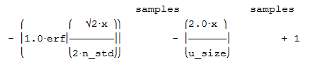
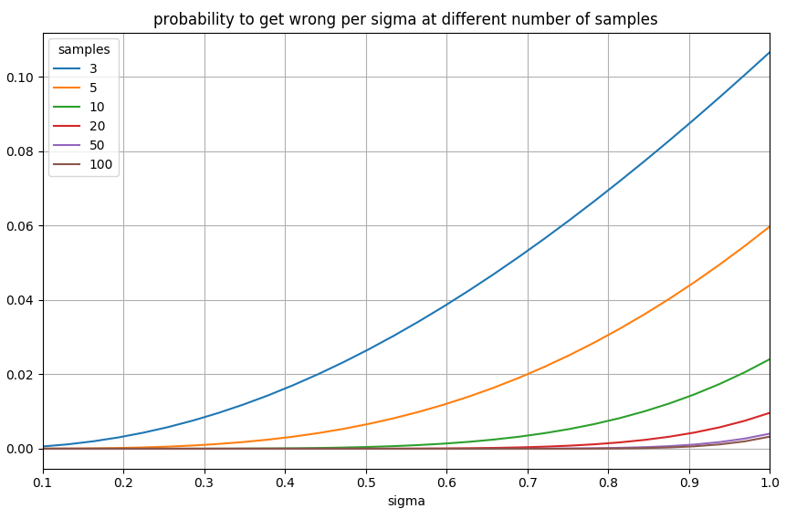
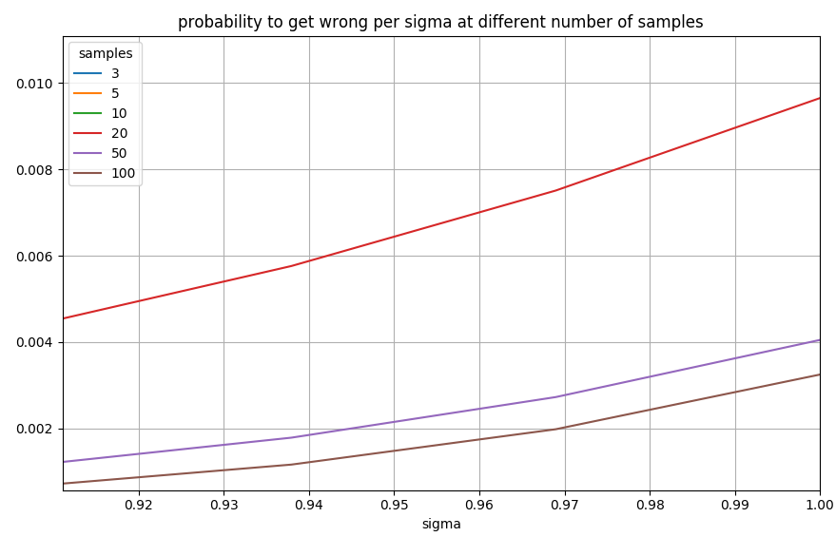
error per sigma

Slide 17
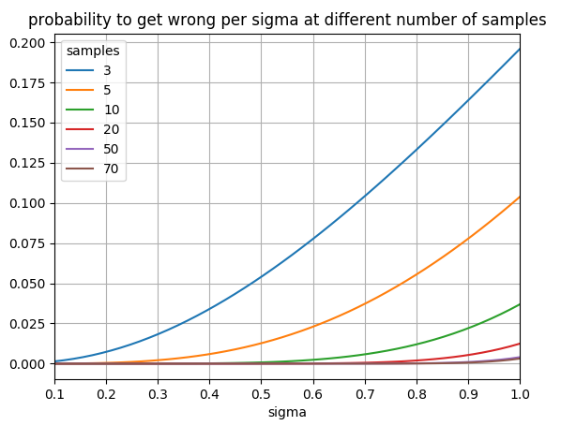
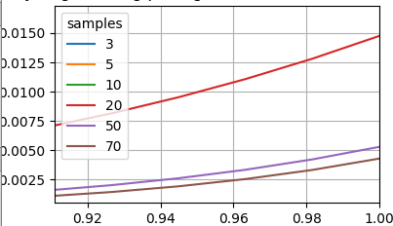
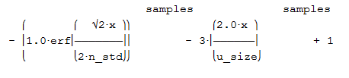
when we allow 3 time more error on N
we have a lot of cases of U but few of N
we can take error at N – meaning saying it’s U while it’s N, but we don’t want error at U – it’s U and we tell it’s N
so we want 3 times more confident at U – less error at U

Slide 18
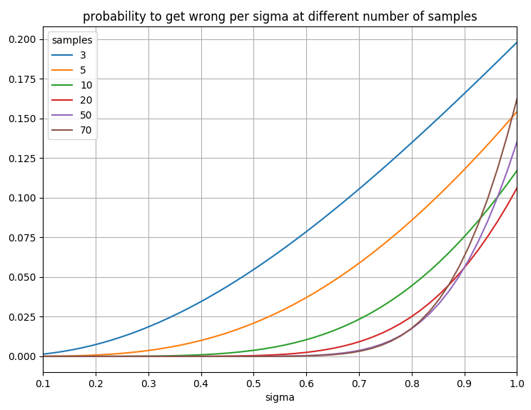
what if we take smaller module… module edge to edge = 6.2 instead of 8.8

Slide 19
python
import scipy.stats as st import pylab as plt import matplotlib.patches as patches import numpy as np import pandas as pd from sympy import simplify,nsolve,Symbol,pprint,lambdify,symbols from sympy.stats import Normal,P from sympy.abc import x # def eqation(): # print("hi") # u_size, n_std, samples = symbols("u_size n_std samples") # nor = Normal(x, 0, n_std) # # print(find_best_threshold_and_error(8.8,1,10)) # u_error = simplify("(x * 2.0 / u_size) ** samples") # n_error = simplify("1 - (1 - 2*cdf) ** samples") # eqtn = n_error - u_error # eqtn = eqtn.subs(Symbol("cdf"), P(nor > x)) # f=lambdify((u_size,n_std,samples),eqtn,modules=['numpy', 'sympy']) # print(f(8.8, 0.3483, 3)) # exit() # return f # eqation() # print(f(8.8,0.3483,3)) # exit() # TODO try to use lambdify - no much help because we need to solve equation with x def find_best_threshold_and_error(u_size,n_std,samples): ''' u_error is when we detect uniform as normal ''' # print(find_best_threshold_and_error(8.8,1,10)) u_n_error_ratio=3 if 1: # much faster way...: u_error = simplify("u_n_error_ratio*((x * 2.0 / u_size)^samples)".replace("u_n_error_ratio",str(u_n_error_ratio))) cdf = "(0.5 + 0.5*erf(-x/(sqrt(2)*n_std)))" n_error = simplify("1 - (1-2*cdf)^ samples".replace('cdf',cdf)) else: nor = Normal(x, 0, n_std) u_error = simplify("(x * 2.0 / u_size)^samples") n_error = simplify("1 - (1-2*cdf)^samples") n_error = n_error.subs(Symbol("cdf"),P(nor>x)) eqtn=n_error-u_error # pprint(eqtn) subs=[(Symbol("samples"),samples),(Symbol("n_std"),n_std),(Symbol("u_size"),u_size)] eqtn=eqtn.subs(subs) threshold=nsolve(eqtn,x,(n_std,u_size/2.0),simplify=False,rational=False , solution_dict=False, verify=False) error=u_error.subs(x,threshold).subs(subs).evalf() # print("u size: %g, n std: %6.04g, samples: %2d, threshold: %6.04g, error: %6.04g"%(u_size,n_std,samples,threshold,error)) return float(threshold),float(error) def plot_single_U_N(modulo,threshold,sigma,samples): u_error,n_error=errors(modulo, threshold, sigma, samples) U_N_errors="%d samples\nthreshold: %.02g\nsigma: %.02g\nuniform edge: %.02g\nU dist, probability to detect as normal : %.02g\nN dist, probability to detect as uniform : %.02g"%(samples,threshold,sigma,modulo,u_error,n_error) fig1 = plt.figure() ax = plt.gca() x_axis = np.arange(-5 * sigma, 5 * sigma, 0.001) plt.plot(x_axis, st.norm.pdf(x_axis, 0, sigma),label="normal") ax.add_patch(patches.Rectangle((-modulo / 2.0, 0), modulo, .1, alpha=0.1,label="uniform")) ax.add_patch(patches.Rectangle((-threshold, 0), 2*threshold, .07, alpha=0.1,facecolor="red",label="threshold")) plt.legend(loc="best",ncol=1, shadow=True, title="in plot:") plt.text(-5 * sigma,0.2,U_N_errors) samples = 5 sigma = 1 modulo = 8.8 sigma_samples=50 print("generating cases") inx=pd.MultiIndex.from_product([[3,5,10,20,50,70],np.linspace(0.1,1,sigma_samples),[modulo]],names=['samples','sigma','modulo']) print("done generating cases") df=pd.DataFrame(index=inx).reset_index(drop=False) print("we have %d cases"%df.index.size) print("calc errors") df[['threshold','error']]=df.apply(lambda x:pd.Series(find_best_threshold_and_error(u_size=x.modulo, n_std=x.sigma, samples=x.samples)),axis=1) print("done calc errors") pt=df.pivot_table(index='sigma',columns='samples',values='error') print(pt) pt.plot(title="probability to get wrong per sigma at different number of samples",grid=True) plt.show()

Slide 20
variance of estimated STD at U and N
at the next ppt…

Slide 21
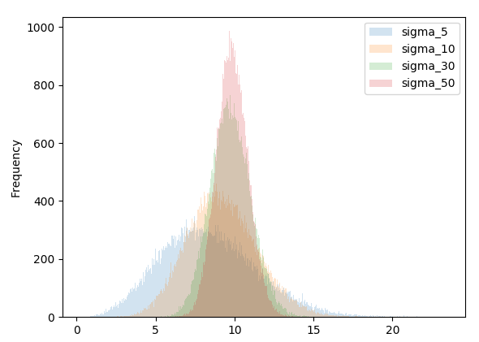

at N: $\frac{\left(n−1\right)s^{2}}{σ^{2}}∼χ_{n−1}^{2}$

